Slide 1
1 / 14
Project Title
Eye Diseases Detection
using
Deep Learning
Department of Electronics and Telecommunication Engineering
Jorhat Institute of Science and Technology

Slide 2
2 / 14
Contents
Content Page ………………………………………………………………………………. Slide: 3
Introduction ....…………………………………………………………………………….. Slide: 4
Literature Review ………………….………………………………………………………. Slide: 5
CNN …………...……………………………………………………………………………. Slides: 6 - 9
Methodology ……...………………………………………………………………………… Slide: 10
Model Flowchart: …………………...………………………………………………………. Slide: 11
Results and Discussion ……………...……………………………………………………… Slide: 12
Limitation & Scope, Summary ..………………………………………………………….. Slide: 13
Reference: …………………………………………………………………………………… Slide: 14
Thank You: …………………………………………………………………………………… Slide: 15

Slide 3
Introduction
3 / 14
Cataract: Cataracts are the leading cause of blindness worldwide, affecting about 20 million people.
Glaucoma: Glaucoma affects more than 76 million people globally and is the second leading cause of blindness worldwide.
Diabetic Retinopathy: Diabetic retinopathy affects approximately one-third of people with diabetes or about 93 million people globally.
Myopia (Near-sightedness): Myopia affects an estimated 1.4 billion people worldwide, with a significant increase expected, potentially reaching 4.8 billion by 2050. In East Asia, where up to 80-90% of high school graduates are myopic.
Age-Related Macular Degeneration (AMD): AMD affects approximately 196 million people worldwide, with the number expected to increase to 288 million by 2040.
Specialized Diagnostic Test Cost:
USA: 100-300 USD
UK: 50-150 EURO
Australia: 50-150 AUD
India: 300-1000 INR

Slide 4
Review of Literature
4 / 14
Dataset Source | Technology | Diseases/Type | Accuracy
Kaggle | DNN | DR & Glaucoma | 80%
DIARETDBI | FKM Clustering | Diabetes-based Eye Diseases | 94.5% - DR Glaucoma – 94.1%
Independent Dataset | DL | AMD | 94.3%
Not Available | ResNET DL | Textual Diagnosis for eye diseases from fundus images | 67%
*DL: Deep Learning; DNN: Deep Neural Network; DR: Diabetic Retinopathy; FKM: Fuzzy K-Means, AMD: Age related macular degeneration

Slide 5
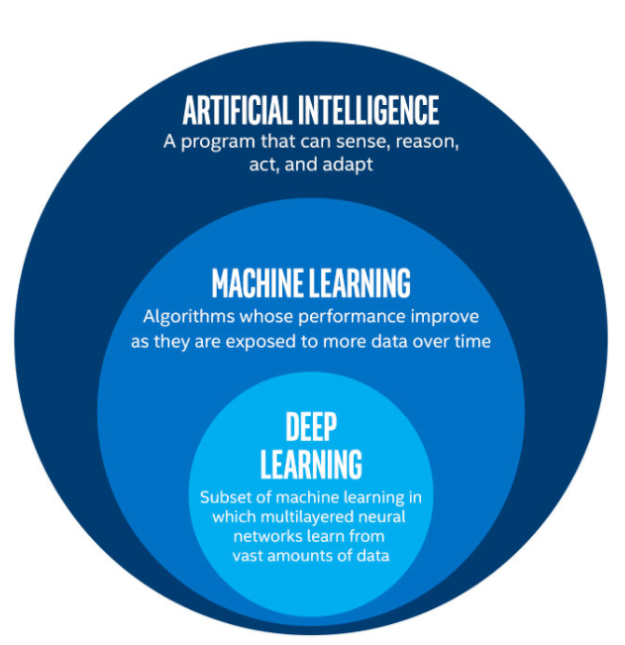
CNN
5 / 14
What is Convolution Neural Network (CNN)?
Within Deep Learning, a Convolutional Neural Network or CNN is a type of Artificial Neural Network widely used for Image/Object Recognition and Classification.
What is TinyVGG?
TinyVGG is a simplified and lightweight version of the VGG (Visual Geometry Group) neural network architecture designed for image classification tasks.
Efficiency: A reduced number of parameters and layers leads to faster training and inference times.
Reduced Risk of Overfitting: The simpler architecture helps prevent overfitting, especially when dealing with smaller datasets.
Practical for Real-World Use: Suitable for practical applications where resources are constrained, but reasonable accuracy is still required.

Slide 6
Basic CNN Architecture
6 / 14
Fully Connected
Convolution
Output
Input
Pooling
Feature Extraction
Classification

Slide 7
7 / 14
Convolutional layers: In CNN architecture, convolutional layers are typically used as the first few layers of the network. These layers are responsible for extracting the most important features from the input image.
Pooling layer: In a Convolutional Neural Network (CNN) architecture, the pooling layer serves several important functions:
Types of Pooling:
Fully Connected (FC) layer: In a Convolutional Neural Network (CNN) architecture, the fully connected (FC) layer acts as a bridge between the feature-extraction stages and the final output. It serves two key functions:
Dimensionality Reduction
Feature Invariance
Computational Efficiency
Max Pooling
Average Pooling
Integrating Features
Classification or Regression

Slide 8
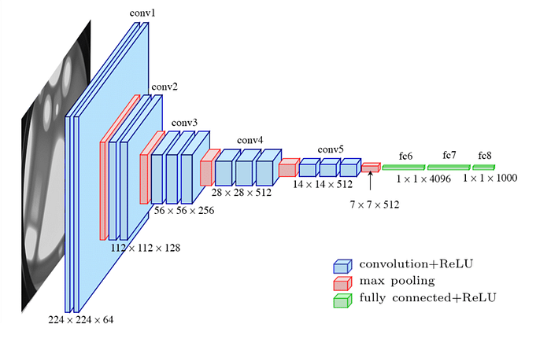
TinyVGG Architecture
8 / 14
Typical TinyVGG Architecture
1. Conv Layer 1: Convolution (3x3 filters, e.g., 32 filters) + ReLU
2. Max-Pool Layer 1: Max-Pooling (2x2)
3. Conv Layer 2: Convolution (3x3 filters, e.g., 64 filters) + ReLU
4. Max-Pool Layer 2: Max-Pooling (2x2)
5. Fully Connected Layer: Dense layer (e.g., 128 neurons) + ReLU
6. Output Layer: Dense layer (number of classes, softmax activation for classification)
Applications
Image Classification: TinyVGG is used for classifying images into different categories, such as detecting various eye diseases from retinal images.
Resource-Constrained Environments: Ideal for applications where computational resources are limited.

Slide 9
Methodology
9 / 14
Define the Problem Statement
Analysis of Solution Techniques
Data Collection
Data Optimization
Model Training & Validation
Testing
Eye Disease | Training Set
Glaucoma | 2016
Cataract | 2052
AMD | 1958
Myopia | 2208
Normal | 2101
Non-Eye | 1985
DR Severity | Training Set
No DR | 720
Mild DR | 160
Moderate DR | 80
Severe DR | 60
Proliferate DR | 45
Glaucoma Type | Training Set
Glaucoma | 292
Healthy | 250

Slide 10
Model Flowchart
10 / 14
Training Images
Trained Dataset
Input Image
Preprocessing
Feature Dataset
Feature Calculation
Let’s See
Working Demo
Feature Matching
Classification Output
CNN Layers

Slide 11
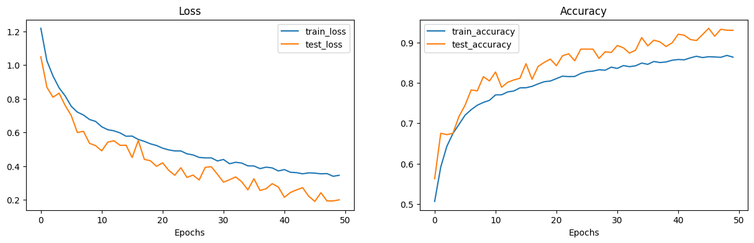
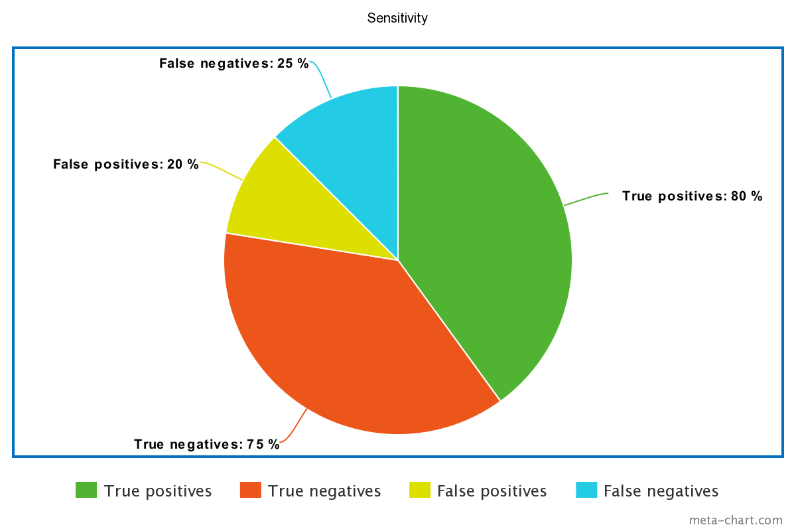
Results and Discussion
11 / 14
For multiple disease detection model:
Total Number of Images: 25
Correctly Predicated: 24
Incorrectly Predicated: 1
Accuracy: 98%
For the Glaucoma detection model:
For DR detection model:
Total Number of Images: 20
Correctly Predicated: 16
Incorrectly Predicated: 4
Accuracy: 80%
Total Number of Images: 20
Correctly Predicated: 18
Incorrectly Predicated: 2
Accuracy: %

Slide 12
12 / 14
Limitation:
Future Scope:
Limited Data Availability
Data Quality and Annotation
Computational Resources
Integration with Clinical Workflow
Improve model accuracy.
Develop models for other eye diseases.
Implement the model in a clinical setting.
Summary:
Deep learning is a promising approach for eye disease detection.
The developed model demonstrates high accuracy and sensitivity.
The model has potential for clinical applications.

Slide 13
13 / 14
References:
[1] Prasad, K., Sajith, P., Neema, M., Madhu, L., & Priya, P. (2019). Multiple eye disease detection using Deep Neural Network. Paper presented at the TENCON 2019-2019 IEEE Region 10 Conference (TENCON).
[2] Nazir, T., Irtaza, A., Javed, A., Malik, H., Hussain, D., & Naqvi, R. A. (2020). Retinal image analysis for diabetes- based eye disease detection using deep learning. Applied Sciences, 10(18), 6185.
[3] Grassmann, F., Mengelkamp, J., Brandl, C., Harsch, S., Zimmermann, M. E., Linkohr, B., . . . Weber, B. H. (2018). A deep learning algorithm for prediction of age-related eye disease study severity scale for age-related macular degeneration from color fundus photography. Ophthalmology, 125(9), 1410-1420.
[4] Sarki, R., Ahmed, K., Wang, H., & Zhang, Y. (2020). Automatic detection of diabetic eye disease through deep learning using fundus images: a survey. IEEE Access, 8, 151133-151149.
[5] Chelaramani, Sahil & Gupta, Manish & Agarwal, Vipul & Gupta, Prashant & Habash, Ranya. (2021). Multi-Task Knowledge Distillation for Eye Disease Prediction. 3982-3992. 10.1109/WACV48630.2021.00403.
[6] Singh, O., & Dubey, P. (2024). Multiple Eye Disease Detection Using Image Processing & Deep Learning techniques. International Journal of Computer Research and Technology (IJCRT), Retrieved from https://www.ijcrt.org/papers/IJCRT2403750.pdf
[7] Kaggle Dataset retrieved from https://www.kaggle.com/datasets/andrewmvd/oculardisease-recognition-odir5k

Slide 14
14 / 14
Thank You!

